Slide 1
Research on the Feasibility and Effectiveness of Robotic Suit Applying in Hong Kong Construction Industry and Suggest Modifications for the Prototypes
5356 4243 Wong Tsz Shing Norman

Slide 2
Contents
Background
Objectives
Methodology
Tasks completed
Tasks to be arranged

Slide 3
Background
According to Labour Department
In this research → Injured whilst lifting or carrying
Top 3 Occupational Injuries in Construction Industry (in 2014)
Strip, trip or fall on same level | 801 cases
Striking against or struck by moving object | 612 cases
Injured whilst lifting or carrying | 490 cases

Slide 4
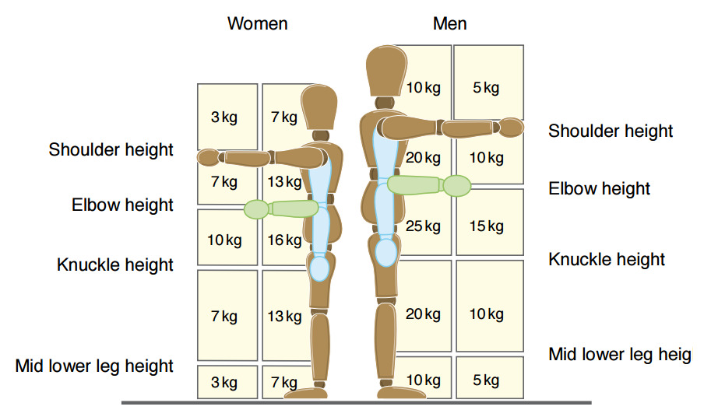
Background (con’t)
Definition of Manual handling:
Using Hands, Arms to move or support loads
Actions included
Lifting
Placing
Pushing
Pulling
Transporting
Picture from: http://www.hse.gov.uk/pubns/indg143.pdf

Slide 5
Background (con’t)
Using Robotic Suit to tackle the problem
At the beginning stage
Lack of analysis on the possibility on adopting the robotic suit in the actual construction site
∴ Feasibility analysis is needed

Slide 6
Objectives
To study the feasibility of the robotic suit in the construction industry in Hong Kong
To analyze the cost effectiveness and the degree of risk reduction by adopting the robotic suit
To suggest better modifications for the existing design to fit Hong Kong’s construction environment.

Slide 7
Methodology
Literature review
Attended demonstration (In Japan)
Site visit
Interview

Slide 8
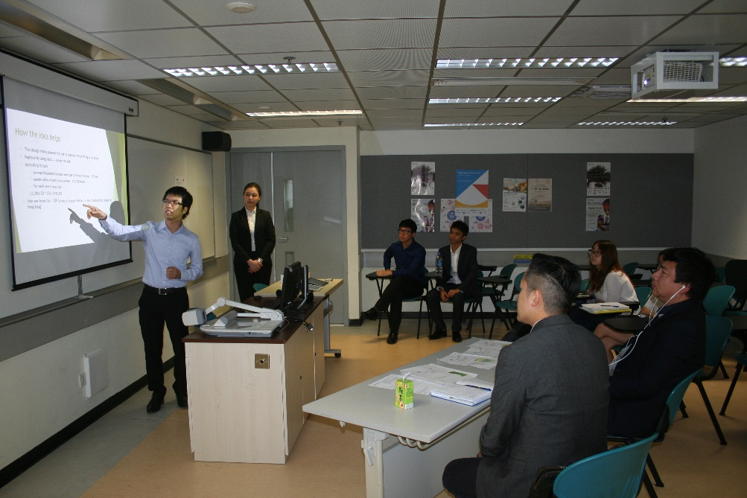
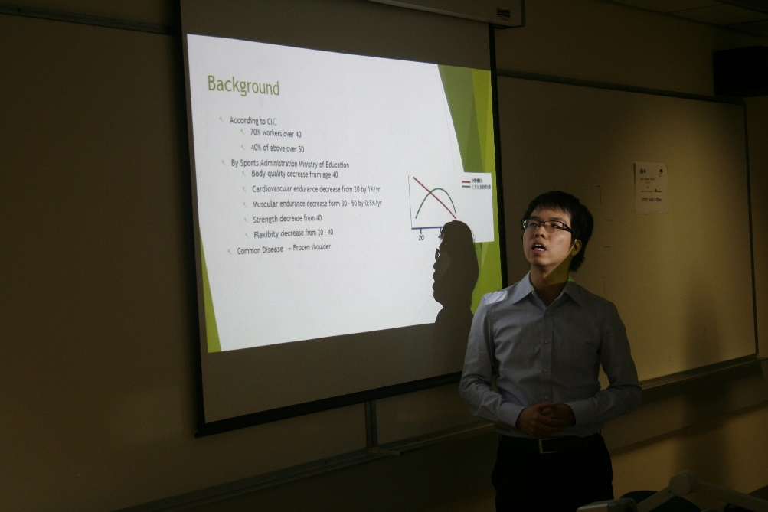
Tasks completed
Meeting with Gammon Innovation Manager, Mr. Andy Wong
Held on 17th Oct, 2016
Presented the idea and got feedbacks about the idea

Slide 9
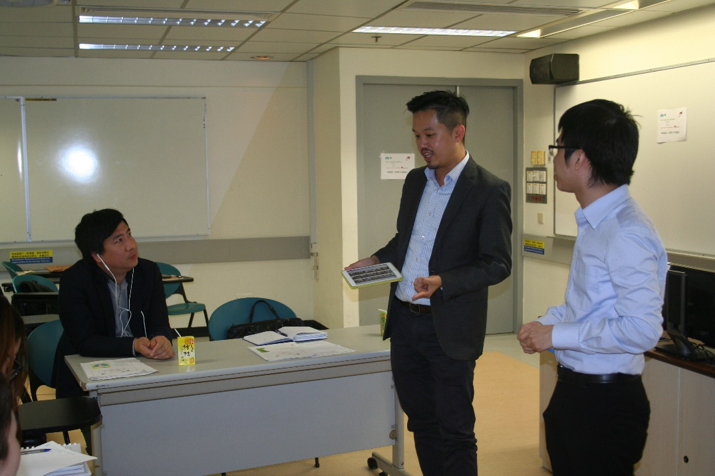
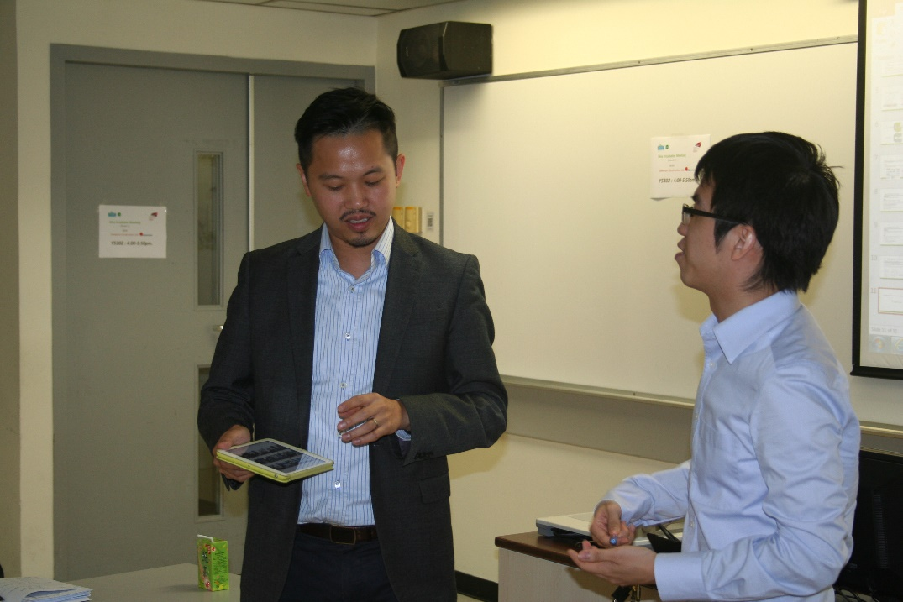
Tasks completed (con’t)
Mr. Andy Wong’s Feedbacks on the topic:
Manual Handling has long been a problem
Gammon has brought two sets of robotic suits for testing purpose
Promised that I can have a site visit and try the robotic suits in Gammon

Slide 10
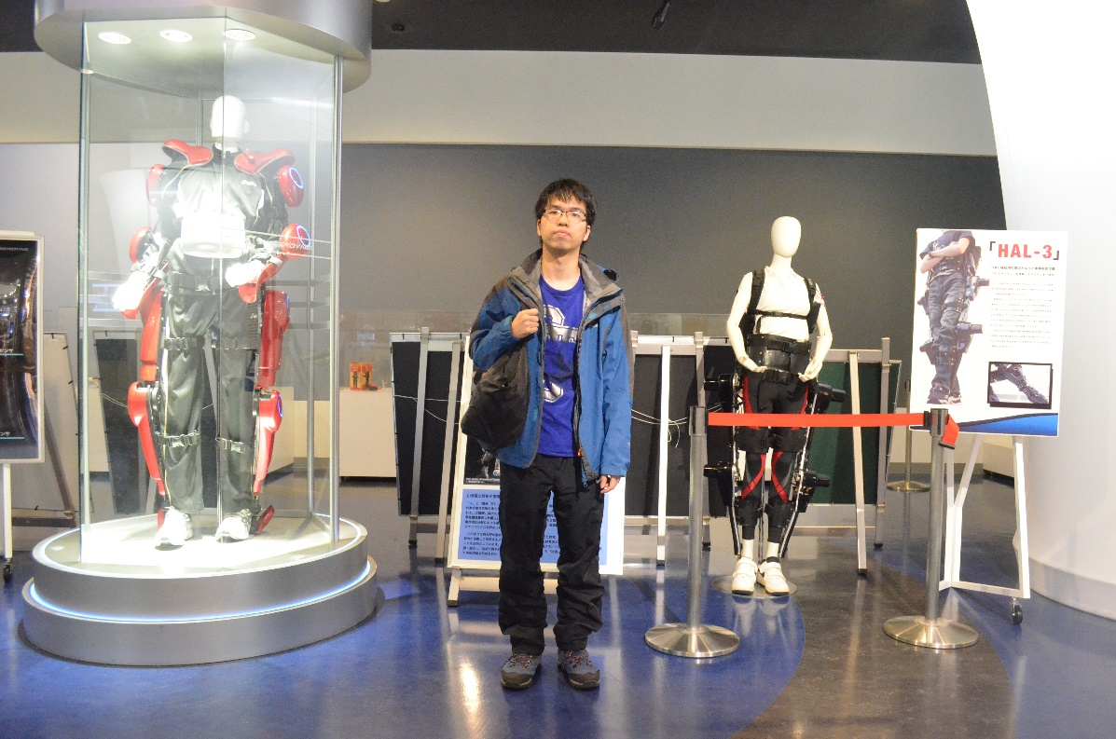
Tasks completed (con’t)
First trial: Attended a demonstration in Japan
26th December 2016 went to Cyberdyine Inc.

Slide 11
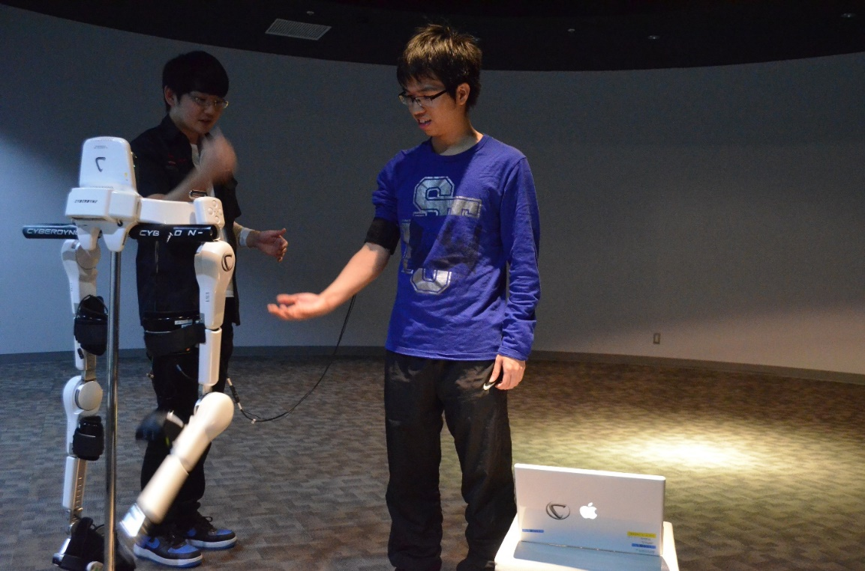
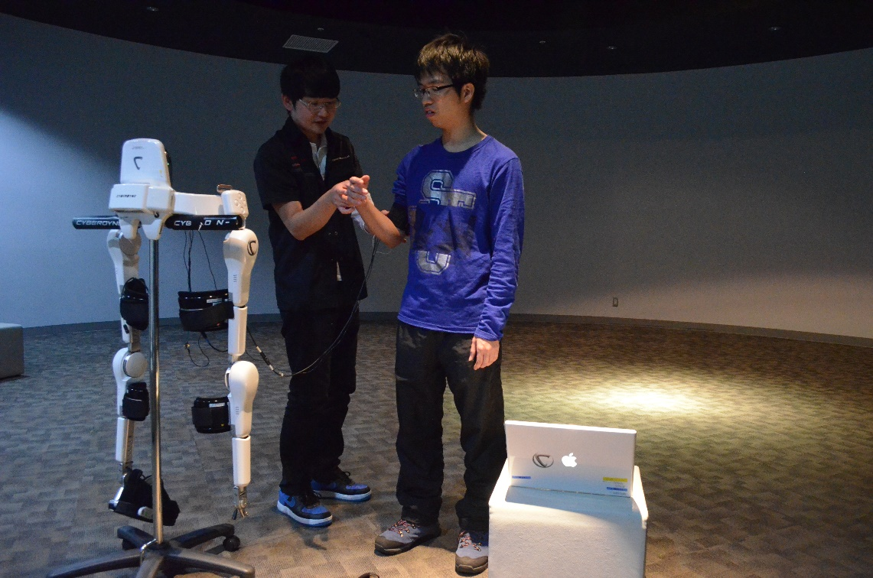
Tasks completed (con’t)
Have tried the Cybermic Voluntary Control
3 conditions
Move with your own will
Try to send nerve signal without moving
Moved by an external force

Slide 12
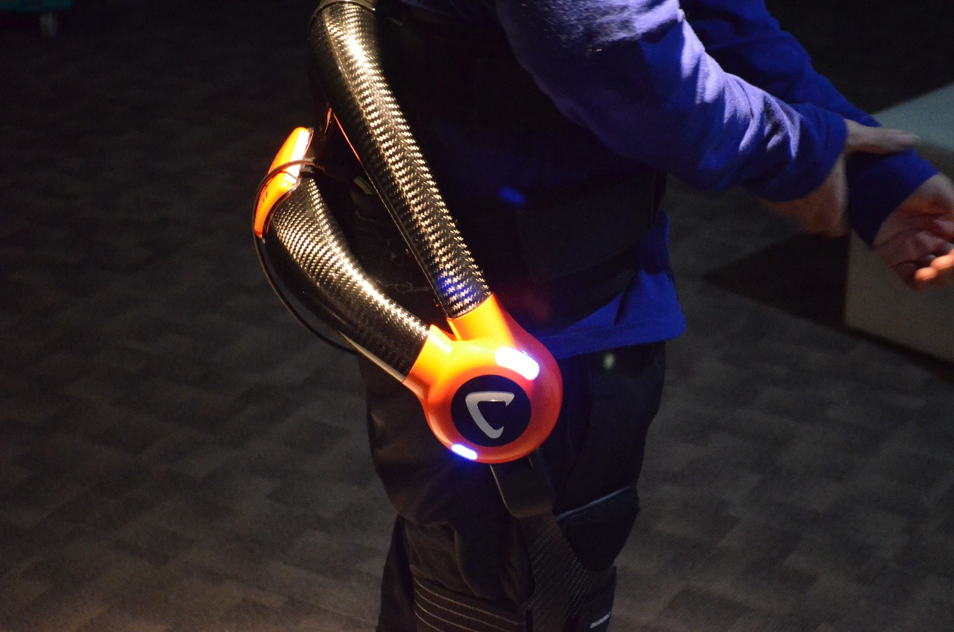
Tasks completed (con’t)
Have tried the prototype of the robotic suit (Lumbar part)
This part can:
Reduce the loads which act on the workers’ lumbar
Prevent injury due to improper posture

Slide 13
Tasks completed (con’t)
When I pick up the heavy object with an improper posture → The robotic suit provides a force on my back
Originally → Load will concentrate on my back → get injured easily
Now → The impact to the back is not significant when I am with the aid of the robotic suit

Slide 14
Tasks completed (con’t)
Analysis of the robotic suit after attended demonstration (Japan)
Good points | Shortcomings
Light-weight | Need time for adaption
Easy to wear | The sensors will be affected by sweat
With 5 Levels of power output | Only acts as an aid and the strength of the user does not change
Can significantly prevent injury caused by improper posture | Has a smaller impact when the worker is in proper posture

Slide 15
Tasks completed (con’t)
Literature review
I) The figures about the problem
According to the report form the Occupational Safety & Health Council and the Labour Department:

Slide 16
Tasks completed (con’t)

Slide 17
Tasks completed (con’t)
Simple Calculation about the loss by injuries of manual handling
Average sick leave (days) X [Monthly Salary/30 days]
= 135 X (23,398/30) = $105,291/case
* Data from ‘OSH Survey of Injured Workers in the Construction Industry in Hong Kong (Chinese version only)’
 | Minimum sick leave (days) | Maximum sick leave (days) | Average sick leave (days) | Median of Monthly Salary
Lifting or transporting object | 1 | 915 | 135 | $23,398/mth

Slide 18
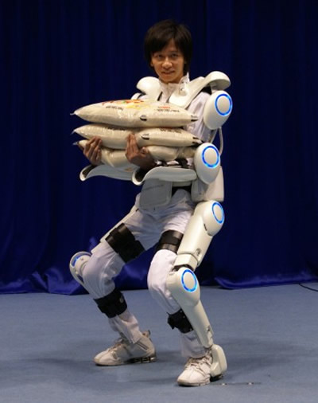
Tasks completed (con’t)
II) Design concept of the robotic suit (by the publication of Cyberdyine Inc.)
Prototype is HAL robotic suit
Cybermic Voluntary Control
With:
Control Unit
Power Unit
Floor reaction force sensor
Bio-electric signal sensor
Picture from: http://www.vyperlook.com/amazing-incredible/robotic-exoskeleton-muscle-suit-will-make-us-superhumans

Slide 19
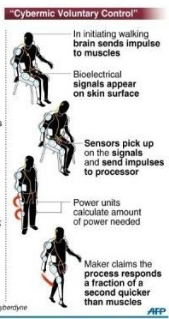
Tasks completed (con’t)
Cybermic Voluntary Control
Brain sends impulse
Bio signal appears on skin surface
Sensor sends impulse to the processor
Sensor picks up signal
Power Unit calculates the amount of power needed
The whole process responds a fraction of a second quicker than muscles
Picture from: https://omallanko.wordpress.com/

Slide 20
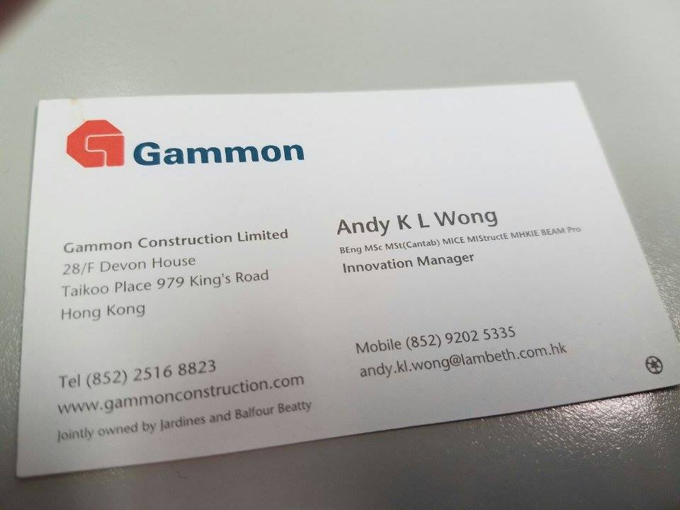
Tasks to be arranged
Site Visit
Observation of the actual working environment
The potential constraints to the adoption of robotic suit
Will contact Mr. Andy Wong for arrangement

Slide 21
Tasks to be arranged (con’t)
Interview
To understand the effectiveness (In risk reduction) of the robot suit
Will Contact Dr. Chan for advices

Slide 22
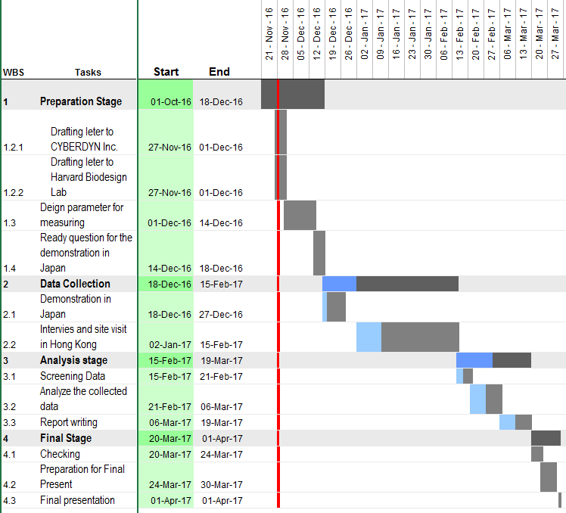
Review on the original schedule
Adjustments
The analysis stage (Report writing included) will re-adjust to 15 Feb 2017 to 6 Mar 2017
The interview and site visit will be arranged as soon as possible

Slide 23
References
1. 香港受傷僱員的職業安全健康狀況調查(2014). Retrieved October 8, 2016 from Occupational Safety & Health Council, Web site: http://www.oshc.org.hk/others/bookshelf/oshc_research_201411.pdf
2. 職業安全及健康統計數字(Aug 2015). Retrieved October 12, 2016 from Labour Department, Web site: http://www.labour.gov.hk/tc/osh/pdf/OSH_Statistics_2014_TC.pdf
3. Soft Exosuits, Retrieved November 24, 2016 from Harvard, School of Engineering and Applied Sciences Web site: http://biodesign.seas.harvard.edu/soft-exosuits
4. Shoemaker, N.,Don't Replace Humans with Robots —Allow Humans to Do What Robots Can. Retrieved November 6, 2016 from Harvard, School of Engineering and Applied Sciences Web site: http://bigthink.com/natalie-shoemaker/suitx-wants-to-enhance-human-laborers-with-max-exoskeleton
5. The World's First Cyborg-type robot "HAL", Retrieved October 3, 2016 from Harvard, School of Engineering and Applied Sciences Web site: http://www.cyberdyne.jp/english/products/HAL/
6. Sankai, Y.,HAL: Hybrid Assistive Limb based on Cybernics. Retrieved November 28, 2016 from http://sanlab.kz.tsukuba.ac.jp/sonota/ISSR_Sankai.pdf
7. Zehr, E. P. (2011).Inventing iron man: the possibility of a human machine.Baltimore: The Johns Hopkins Unversity Press.

Slide 24
~Q & A~

